Slide 1
DocumentDB
Notes:
Now let’s focus on the new Microsoft Azure DocumentDB Service!

Slide 2
Fully managed, scalable JSON document database service

Slide 3


Microsoft Azure Data Services
SQL Server in a VM
SQL Database
DocumentDB
Tables
Blobs
fully managed, scalable, queryable, schemafree JSON document database service for modern applications
fully featured RDBMS
transactional processing
rich query
managed as a service
elastic scale
schema-free data model
internet accessible http/rest
arbitrary data formats

Slide 4
MongoDB
DocumentDB
Existing applications which require extra capacity for scale out and can not be migrated
Customer has ecosystem of IT resources for support and maintenance
Removing CAPEX
Mongo MMS compatibility
Applications that need managed elastic scale, query over schema free data, native JSON/JavaScript support
Customer does not want to add additional IT resources for support and maintenance
Avoiding CAPEX and OPEX
Built-for-the-cloud database technology

Slide 5
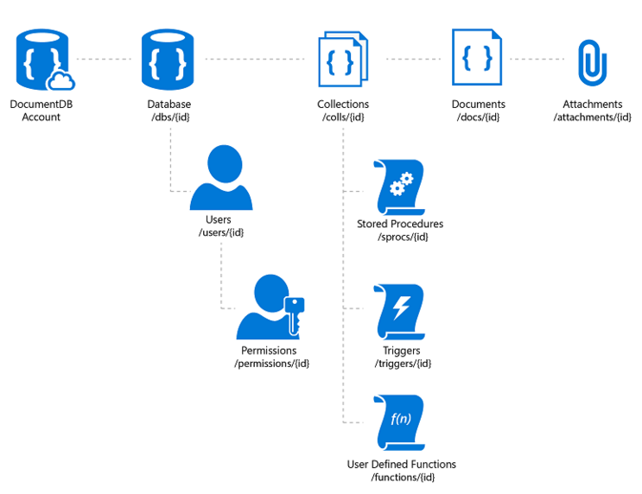
DocumentDB Resources
Notes:
Default indexing - tunable

Slide 6
Indexing
Defaults
Customizable
Notes:
Configurable consistency to trade off consistency and performance.
Database Accounts are configured with a default consistency level.
Consistency level can be weakened per read/query request.

Slide 7
Tunable Consistency – four distinct levels
Strong Bounded Stateless Session Eventual
Notes:
Configurable consistency to trade off consistency and performance.
Database Accounts are configured with a default consistency level.
Consistency level can be weakened per read/query request.

Slide 8
Tunable Consistency Strong
All writes are visible to all readers. Writes synchronously committed by a majority quorum of replicas and reads are acknowledged by the majority read quorum.

Slide 9
Tunable Consistency Bounded Stateless
Guaranteed ordering of writes, reads adhere to minimum freshness. Writes are propagated asynchronously, reads are acknowledged by majority quorum lagging by at most K prefixes.

Slide 10
Tunable Consistency Session
Read your own writes. Writes are propagated asynchronously while reads for a session are issued against the replica that can serve the requested version.

Slide 11
Tunable Consistency Eventual
Reads eventually converge with writes. Writes are propagated asynchronously while reads can be acknowledged by any replica. Readers may view older data then previously observed.

Slide 12
Tunable Consistency
 | Writes | Reads
Strong | sync quorum writes | quorum reads
Bounded | async replication | quorum reads
Session | async replication | session bound replica
Eventual | async replication | any replica
*
* | Ideal consistency and performance tradeoff for many application scenarios. High performance writes and reads with predictable consistency.

Slide 13
Partitioning Data
Single Multiple Infinite scale
Notes:
Speaker notes:
Achieve near-infinite scale in terms of storage and throughput by horizontally partitioning data(sharding)
Best partition option for data across collections will depend on data format and access patterns
DocumentDB accounts can be scaled linearly with cost via collections

Slide 14
Partitioning Transparent
Can be configured based on a document property during setup. Queries and writes automatically route to the correct partition.
Notes:
Speaker notes:
This is commonly used to partition data produced or consumed from a large number of distinct clients, and is useful for storing user profiles, catalog items, and IoT ("Internet of Things") telemetry data.
You should use hash partitioning whenever there are too many entities to enumerate through lookup partitioning (e.g. users or devices) and the request rate is fairly uniform across entities.
Hash partitioning is useful for uniform load balancing of requests to make effective use of your provisioned storage and throughput. Using consistent hashing algorithms allow you to minimize the amount of data that has to be moved when adding or removing a partition.

Slide 15
Server-side JavaScript
Stored Procedures Triggers UDFs
Notes:
Achieve transactions through stored proceedures and trigger operations
UDFs allow you to extend canned query functionality

Slide 16
Demo: Interacting with DocumentDB
Notes:
Demo 5)

Slide 17
Q&A

Slide 19


Get started
Visit azure.microsoft.com

